Slide 1
End of Distribution Imputation
Subject: Data Mining
Lecturers: Phauk Sokkhey & Chan Sophal
Presenter: Choeng Veyseng

Slide 2
Table of Content
Definition
Which variable is fit for this method?
How to use it?
Code Implementation
Advantages & Disadvantages

Slide 3
Definition
End of Distribution Imputation
is equivalent to arbitrary value imputation, but it automatically selecting arbitrary values at the end of the variable distribution known as outlier.
If the variable is normally distributed, can use the mean plus or minus 3 times the standard deviation(SD)
If the variable is skewed, can use the IQR( Inter-Quantile Range ) proximity rule.

Slide 4
Which variable is fit for this method?
Suitable numerical variables

Slide 5
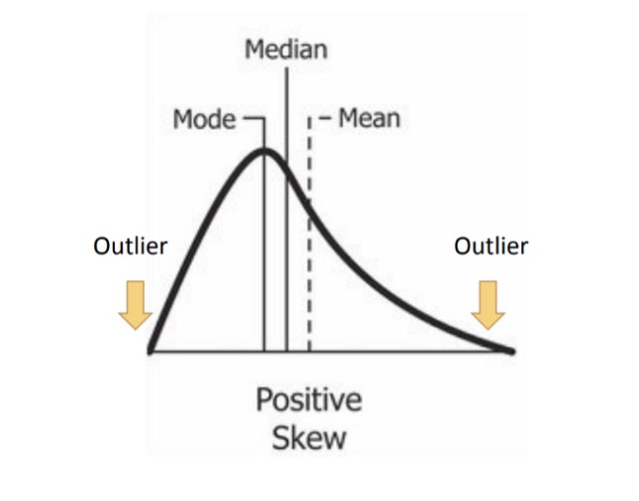
How to use it?
Skew Distributions
The general approach is to calculate the quantile, and then the inter-quantile range(IQR)
IQR = 75th Quantile - 25th Quantile
Upper limit = 75th Quantile + IQR x 1.5
lower limit = 25th Quantile - IQR x 1.5
Extreme outliers will time 3 instead of 1.5

Slide 6
Code Implementation

Slide 7
Advantages & Disadvantages
Advantages
Easy to implement
Rapid way of obtaining complete dataset
Can be integrated into production
Capture the importance of “Missingness” if there is one
Disadvantages
Distortion of the original variable distribution
Distortion of the original variance
Distortion of the covariance with the remaining variables of dataset
This technique may mask true outliers in the distribution

Slide 8
References:
https://medium.com/analytics-vidhya/feature-engineering-part-1-end-of-tail-imputation-c5069a41869a
https://www.kaggle.com/code/rushikeshlavate/end-of-distribution-imputation/notebook

